Slide 1
Parents Workshops 2025
Reading and Maths
Year 1 and 2

Slide 2
How will the sessions work?
Each week you will have a 30 minute session which will alternate
between maths and reading.
The sessions are designed to give you an insight into current methods
your child is learning.
It will provide practical support that you can use at home to help
your child.
These sessions will help you to be positive role models in the subjects
for your child.

Slide 3

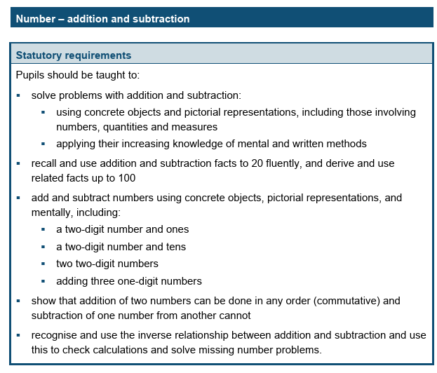
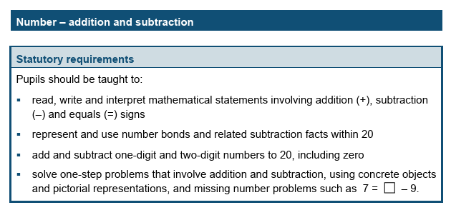
Addition and Subtraction in Year 1 and 2
Year 2
Year 1

Slide 4
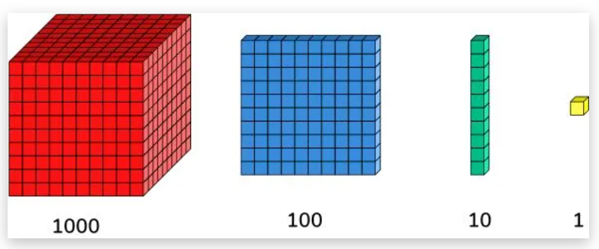
Diennes
Notes:
Diennes on the tables
Show and use the word exchange
12 + 5
25 + 18
14- 8

Slide 5
Diennes
Have a go..
54 + 17
23 - 9
Notes:
Show
12 + 5
25 + 18
14- 8

Slide 6

Ten Frames
Notes:
20 counters and 2 tens frame to take home
Go over filling up to make 5 then 10
Show
3 + 7
13 + 5
15 – 9

Slide 7
Ten Frames
Have a go
6 + 5
19 – 11
Notes:
Go over filling up to make 5 then 10
Show
3 + 7
13 + 5
15 – 9

Slide 8
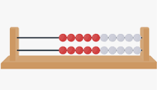
Rekenreks
Notes:
Model one push

Slide 9
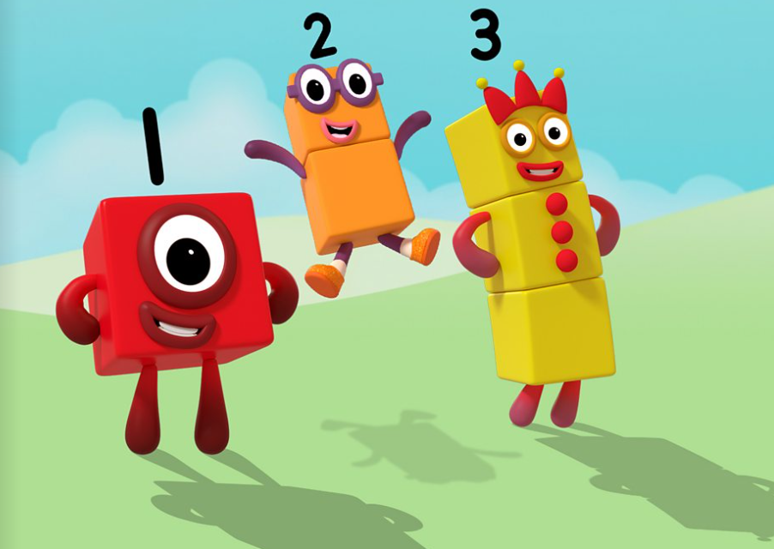
Supporting your child at home
https://www.bbc.co.uk/iplayer/episodes/b08bzfnh/numberblocks

Slide 10
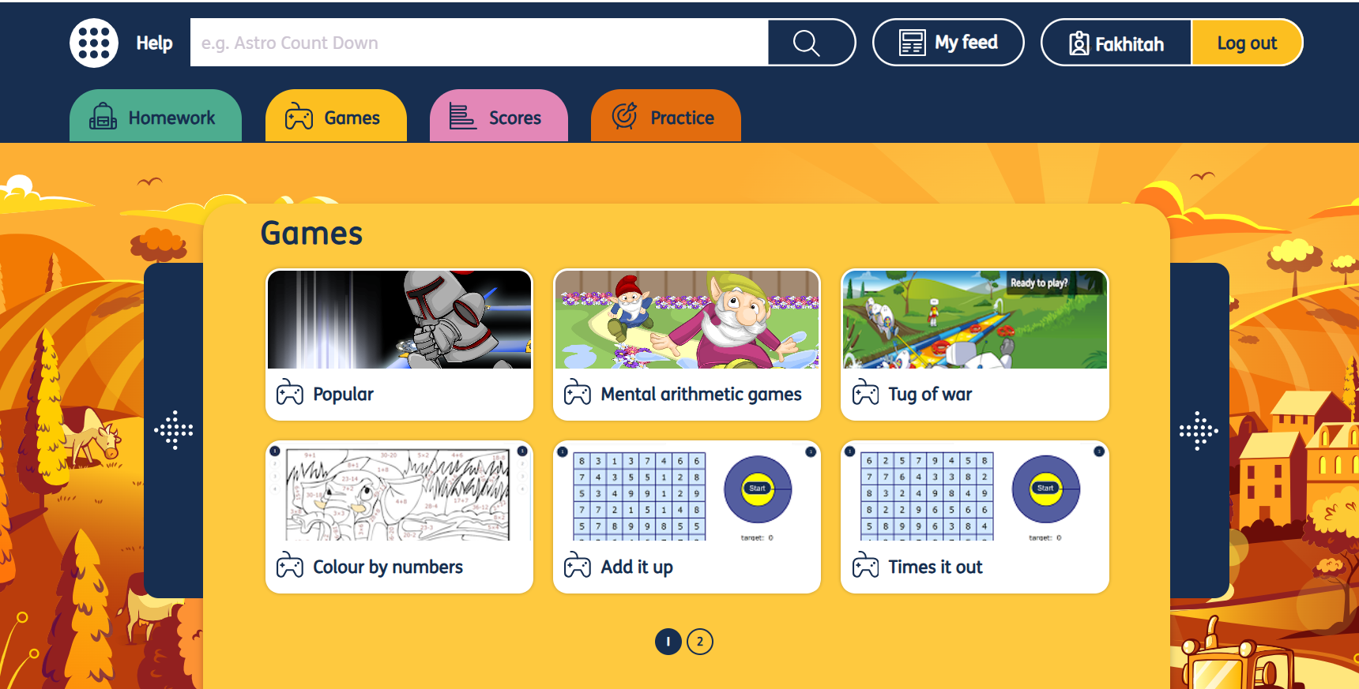
Mymaths games
Your child should have a login for Mymaths from their class teacher

Slide 11
Useful Websites
• BBC Bitesize – lots of information alongside short videos help to make the learning enjoyable and accessible for all children. Particularly look out for ‘Guardians of Mathematica’.
• I See Maths – a useful site with a plethora of ideas for fun games that all the family
https://www.iseemaths.com/early-number/
• Primary Games Arena - It is a free website that encourages children to play online maths games linked to their home learning. It breaks the games down into concepts which is really helpful.
• Hit the Button – children love this game as it helps to increase confidence through practising times tables and number bonds.
• Maths Zone – this site is jam-packed with fun ways to learn more about Maths

