Slide 1
Times Tables Parent Workshop
October 2025

Slide 2
Why is learning times
tables important?

Slide 3
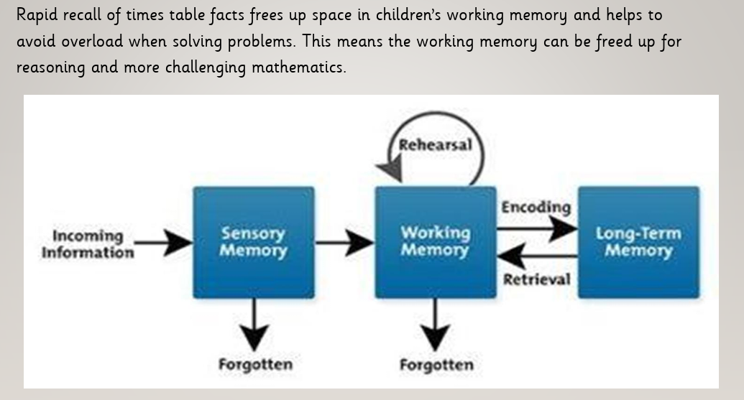

Slide 4
How do children
learn times tables?

Slide 5
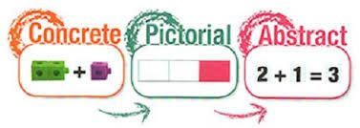
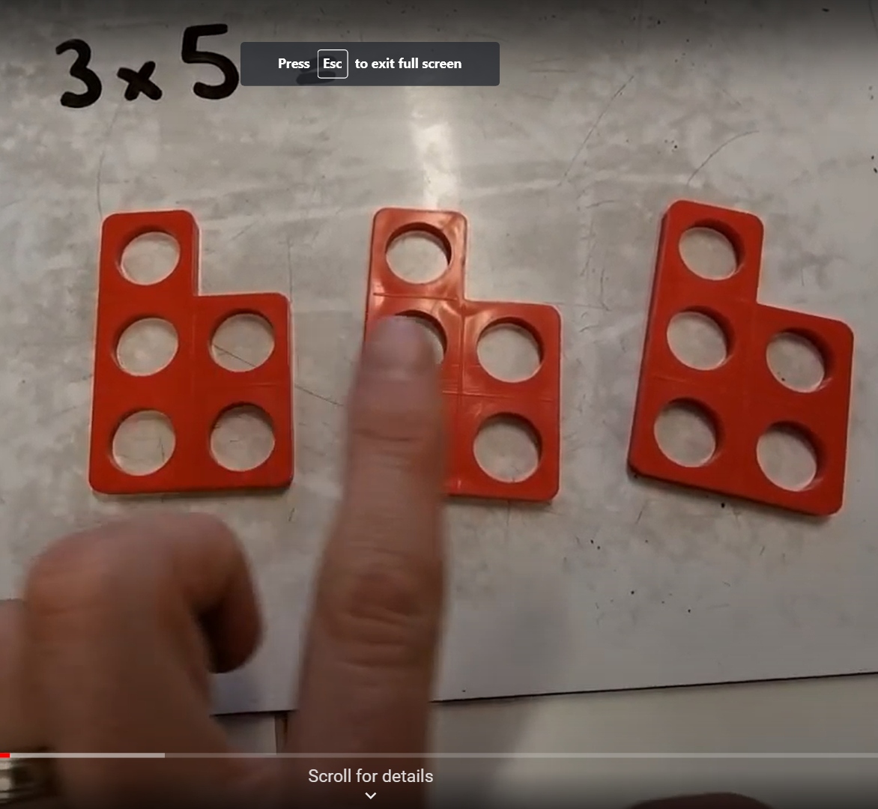
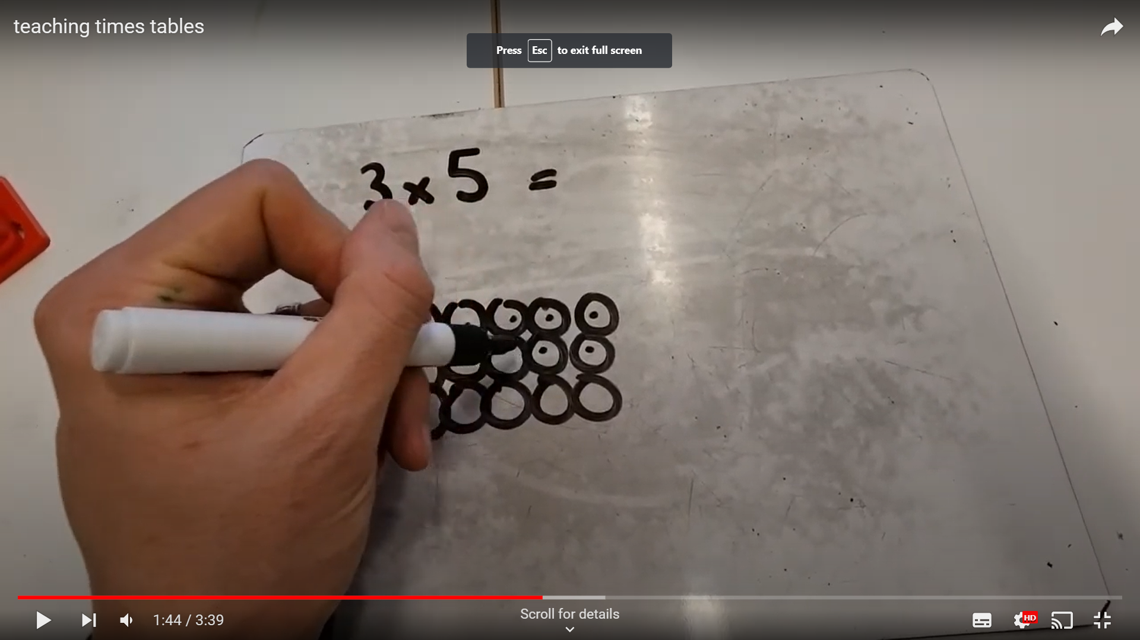
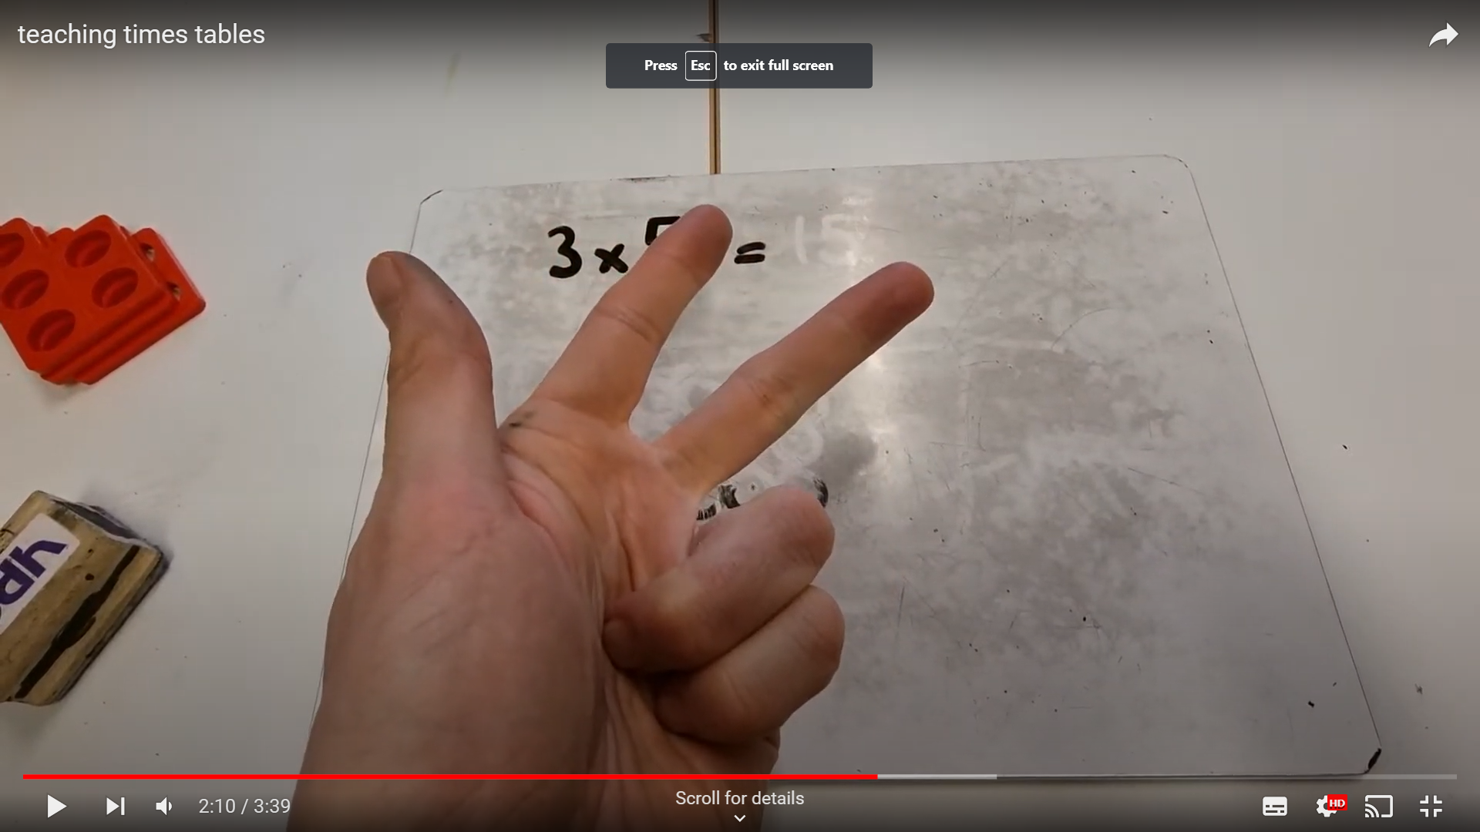
3 x 5 = 15
Notes:
Understanding times-tables and developing strategies to solve them is really important

Slide 6

Counting and looking for patterns
Example: Counting in 2s
2, 4, 6, 8, 10…
Ensure children have a strong understanding of counting in groups first.
When children are secure with counting, they can then look for patterns.
Notes:
Counting will start before beginning to develop understanding and reasoning but will continue long after, until all times tables can be counted through sequentially at speed.
Counting using manipulatives should start with physical objects (shoes, socks, hands etc) before moving on to counters etc
Whenever starting children counting in a new amount, such as counting in 8s, children should be given the opportunity to see visually what that looks like to reinforce 4 x 8 looks quite big compared to 4 x 6.
Patterns could be 4 x 8 is the same as 4 x 4 doubled.

Slide 7
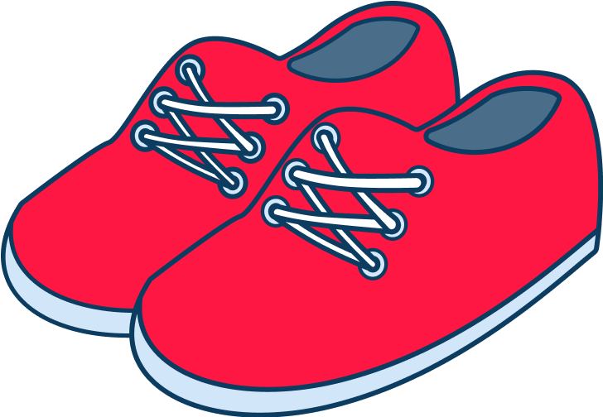

Repeated addition
Knowing that 2 x 4 is the same as 2 + 2 + 2 + 2
2 + 2 + 2 + 2 = ?
2 x 4 = ?
Notes:
Children need experience of using concrete manipulatives such as counters or multilink cubes and pictorial representations of objects, forming arrays.

Slide 8


Multiplication is commutative
3 x 2 is the same as 2 x 3
Children need to understand that multiplication can be completed in any order to produce the same answer. Sometimes this link needs to be made explicit.
3 lots of 2 = 6
2 lots of 3 = 6
Notes:
Children build on their existing understanding using arrays, turning the arrays around to show that you now have 2 groups of 3 and they will still total 6. This can then be linked to recalling multiplication facts, e.g. if they know their 2 times table as facts but not their 3 times table, they can use 2 x 3 to work out 3 x 2.

Slide 9

Multiplication is the inverse of division
20 ÷ 5 = 4 can be worked out because 5 x 4 = 20
Using pictorial representations (such as arrays) is useful here for children to see the link between multiplication and division.
Notes:
Even though division is not tested in the MTC, it is important that pupils have a strong understanding of the connection between multiplication and division.
Again, the use of arrays is key. Children need experience of pulling arrays apart into groups or sharing. After basic experience has been gained, the children should start to ‘see’ an array structure as 5 groups of 4 equal 20 and 20 can be split into 5 groups of 4.

Slide 10
Fact families
4 x 5 = 20, 5 x 4 = 20, 20 ÷ 5 = 4, 20 ÷ 4 = 5
Due to their commutative understanding, children should also be able to see whole number families. For many children this will need to be pointed out and discussed.
20
4
5
Notes:
From here it is only a short jump to understanding that any missing number can be worked out through knowledge of fact families, e.g. 4 x [ ] = 20 or [ ] ÷ 4 = 5. There are other methods children can use to work out missing numbers but our goal is to increase working memory in order to increase instant recall from long term memory. Being able to bounce around a fact family will achieve that.

Slide 11
Using known facts
4 x 6 = ?
I know 4 x 5 = 20
Therefore, 20 + 4 = 24
By using known facts from ‘easier’ times tables, children should be able to find answers with increasing speed.
+

Slide 12
MTC
Multiplication Check 2026

Slide 13
What is the purpose of the multiplication check?
The purpose of the MTC is to determine whether year 4 pupils can fluently
recall their multiplication tables and are meeting the expected standard for
their year group before moving to Upper Key Stage 2 (Year 5 and Year 6)
‘By the end of year 4, pupils should have memorised their multiplication tables up to
and including the 12 multiplication table and show precision and fluency in
their work’.
Recent research shows children who pass the check are more likely to pass
their Year 6 sats papers

Slide 14
Important information about multiplication tables check (MTC)
The MTC determines if Year 4 children can fluently recall their
multiplication tables.
They are designed to help schools identify which children require more
support to learn their times tables.
There is no ‘pass’ rate or threshold which means that, unlike the Phonics
Screening Check, children will not be expected to re-sit the check.
The Department for Education (DfE) will create a report about the overall
results across all schools in England, not individual schools.
Notes:
The test is designed to identify pupils who need support, not as a diagnostic tool to assess the times tables children struggle with.
https://www.gov.uk/government/collections/multiplication-tables-check

Slide 15
When the check will take place
There will be a 2 week window in June for schools to administer the check.
There is no set day to administer the check and children are not expected to
take the check at the same time.
All eligible Year 4 children in England will be required to take the check.
Notes:
It is up to individual schools to decide how the check is administered – some schools will administer individually while others will take small groups out or administer to the whole class.
A list of pupils who should not take the test can be found in the administration guidance of the MTC documentation.

Slide 16
How the check is carried out
The check will be fully digital.
Answers will be entered using a keyboard, by pressing digits using a
mouse or using an on-screen number pad.
Usually, the check will take less than 5 minutes for each child.
The children will have 6 seconds from the time the question appears to input
their answer.
There will be a total of 25 questions with a 3 second pause in-between questions.
There will be 3 practice questions before the check begins.
Notes:
Some children will be eligible for additional support (detailed in the next slide).
6 seconds per answer means that children must be able to read, recall and enter their response within that time. Whatever is written in the answer box at the end of 6 seconds will be counted as the answer i.e. if the student intends to write 144 and only 14 is typed when the timer ends, their recorded answer is 14.
Children are allowed to practise before taking the check.
https://mathsframe.co.uk/en/resources/resource/477/Multiplication-Tables-Check example showing how quick the questions are/ types of questions.

Slide 17
The check questions
Each child will be randomly assigned a set of questions
There will only be multiplication questions in the check, not division facts.
The 6, 7, 8, 9 and 12 times tables are more likely to be asked.
Reversal of questions (e.g. 8 x 6 and 6 x 8) will not be asked in the same
check.
Children will not see their individual results when they complete the check.
Notes:
Some questions will be repeated across different checks, but no more than 30% of questions will be repeated in any two checks. This means that if the check gets interrupted and children need to re-start it, they will only have a minimal advantage.
During the check pupils may be able to restart if certain conditions are met (e.g. a fire alarm).
The results will be sent to the schools when all the checks have been completed but it is then up to the school if they report the results or not.
There won’t be questions from the 1 times tables (although they might be included in the 3 practice questions).
There will be a maximum of 7 questions from the 2, 5 and 10 times tables.
There is a focus on the 6, 7, 8, 9 and 12 times tables as they are the ‘most difficult’ multiplication tables.

Slide 18

More information about the questions
The Standards and Testing Agency (STA) state that they are classifying the multiplication tables by the first number (multiplier) in the question. For example, 8 x 3 would fall within the 8 times table.
Notes:
The table shows the minimum/ maximum number of questions from each times table that will be asked.

Slide 19
The following 11 multiplication questions
are more likely to be asked:
6 x 6, 6 x 7, 6 x 8, 6 x 9, 6 x 12
7 x 8, 7 x 9, 7 x 12
8 x 9, 8 x 12
12 x 12

Slide 20
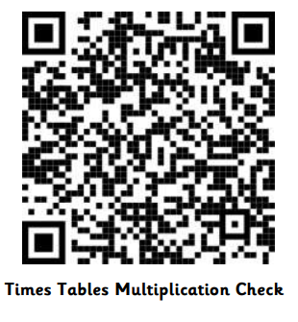
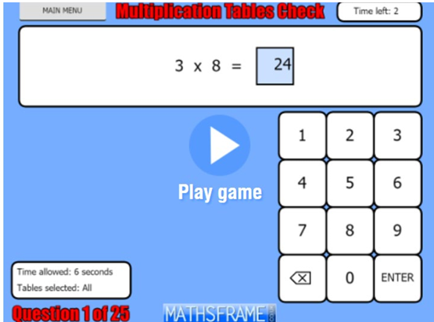
Lets have a go
https://mathsframe.co.uk/en/resources/resource/477/MultiplicationTables-Check

Slide 21
Resources you can
use at home

Slide 22
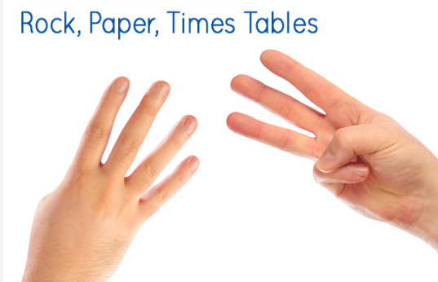

Slide 23
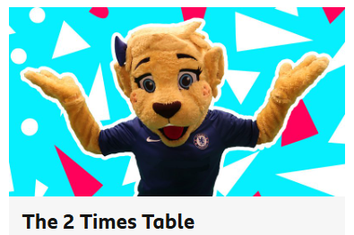
https://www.bbc.co.uk/bitesize/articles/z97rdnb#zwt8239
https://www.bbc.co.uk/teach/topics/cnep90jwjj7t

Slide 24
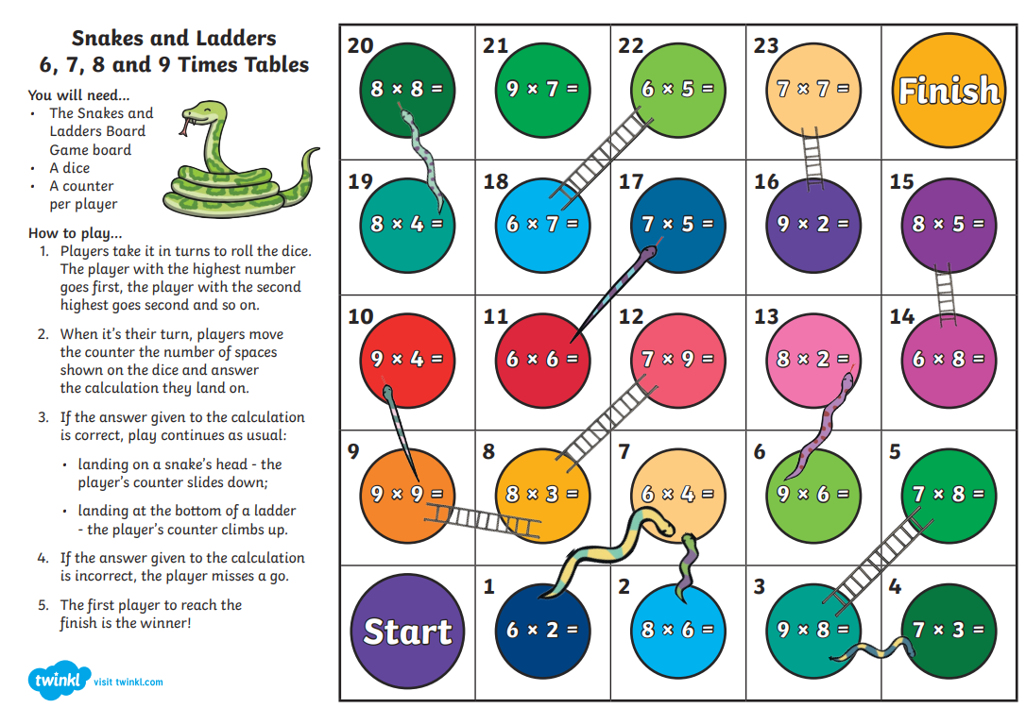

Slide 25
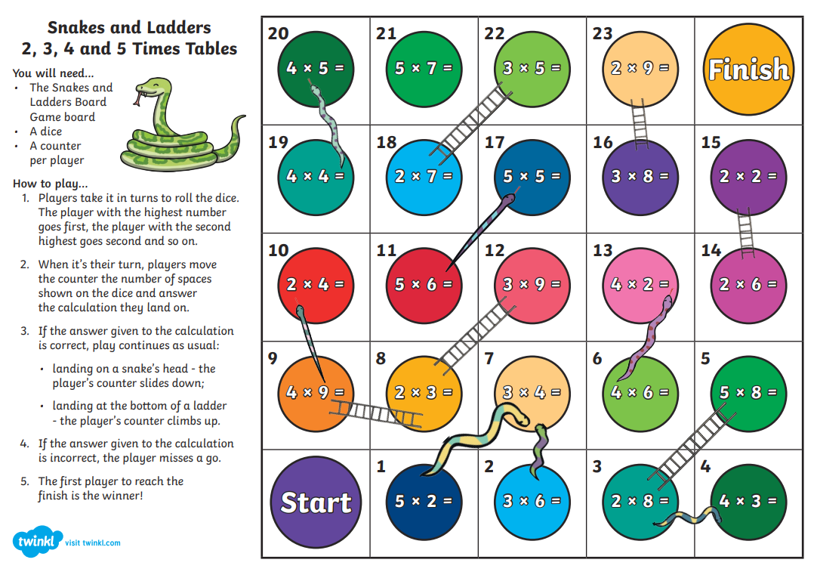

Slide 26


Slide 27


