Slide 1
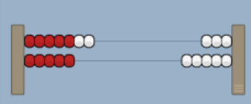
Notes:
Add and subtract within 10 , add and subtract within 20 13 + 5 13 – 6 ( look at he different ways they could do it )

Slide 2
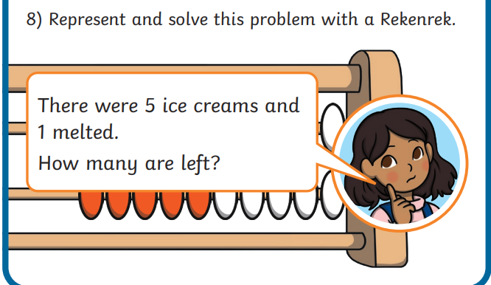

Slide 3
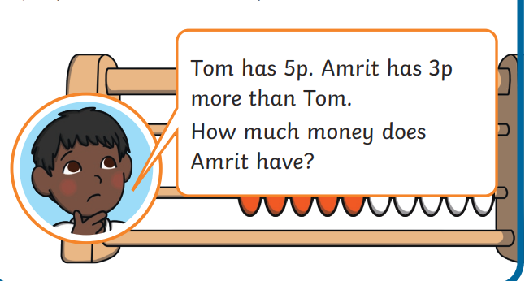

Slide 4
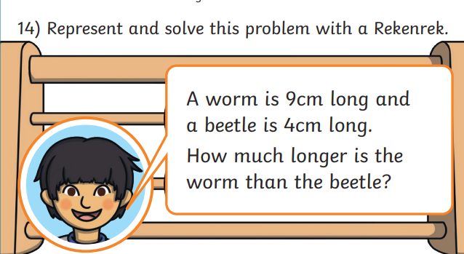

Slide 5
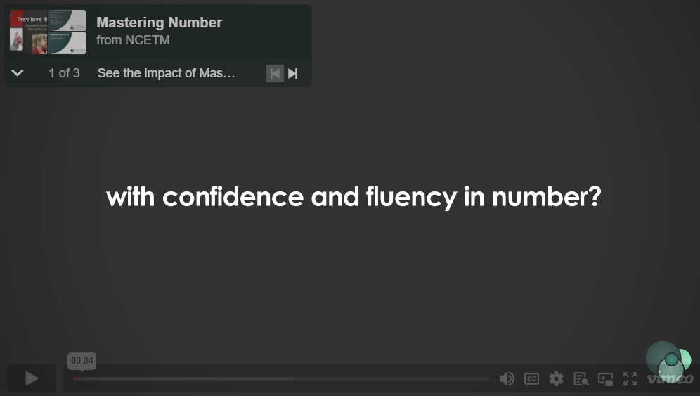
https://www.ncetm.org.uk/maths-hubs-projects/mastering-number-at-reception-and-ks1/#:~:text=This%20national%20programme%20%2D%20now%20in,the%20impact%20of%20Mastering%20Number

Slide 6
Lets try some sessions
Year 2 in the Summer term

Slide 7
Session 1
Mastering Number 2021/22 ncetm.org.uk

Slide 8
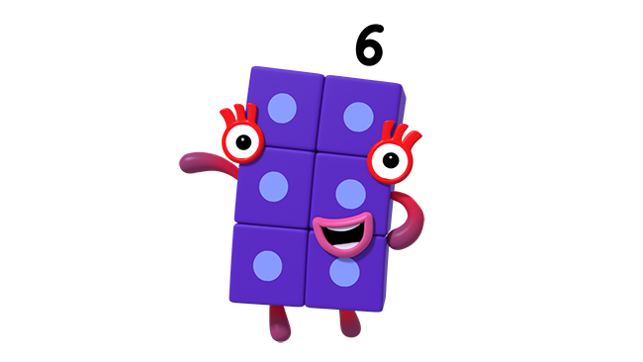
Match the pictures to the correct expression and then say the double.
Image © 2021 Alphablocks Ltd. All rights reserved. Mastering Number 2021/22 ncetm.org.uk

Slide 9
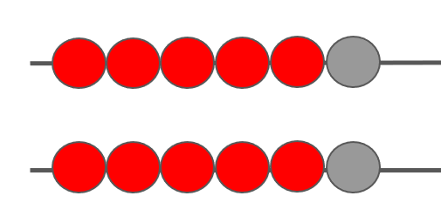
6 | + | 6 |  |  | 7 | + | 7 |  |  | 8 | + | 8 |  |  | 9 | + | 9
Double _____ is _____ .
Mastering Number 2021/22 ncetm.org.uk

Slide 10
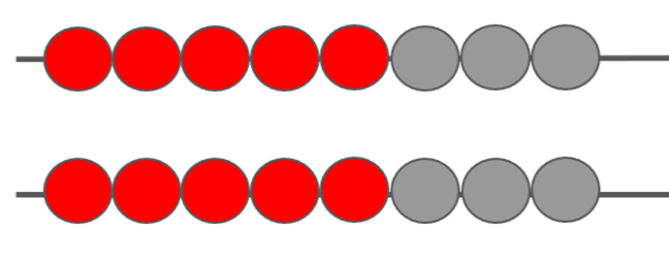
6 | + | 6 |  |  | 7 | + | 7 |  |  | 8 | + | 8 |  |  | 9 | + | 9
Double _____ is _____ .
Mastering Number 2021/22 ncetm.org.uk

Slide 11
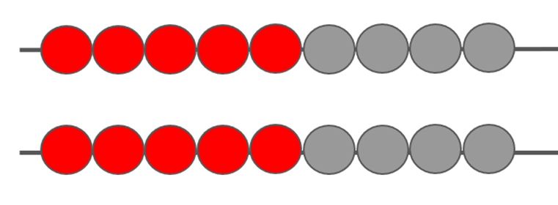
6 | + | 6 |  |  | 7 | + | 7 |  |  | 8 | + | 8 |  |  | 9 | + | 9
Double _____ is _____ .
Mastering Number 2021/22 ncetm.org.uk

Slide 12
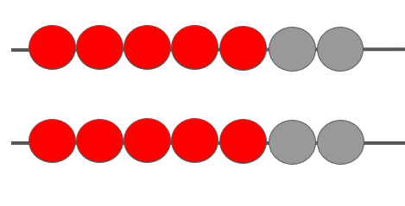
6 | + | 6 |  |  | 7 | + | 7 |  |  | 8 | + | 8 |  |  | 9 | + | 9
Double _____ is _____ .
Mastering Number 2021/22 ncetm.org.uk

Slide 13
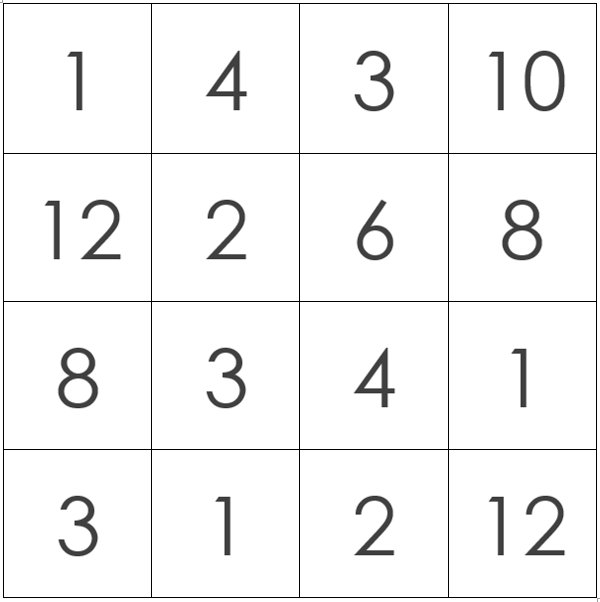
I will have the purple-dot die and you will have the red-dot die!
Choose whether to double or halve the number shown on the die.
Would you like to play my 3-in-a-row dice game?
Image © 2021 Alphablocks Ltd. All rights reserved. Mastering Number 2021/22 ncetm.org.uk

Slide 14
Mastering Number 2021/22 ncetm.org.uk

Slide 15
Session 2
Mastering Number 2021/22 ncetm.org.uk

Slide 16
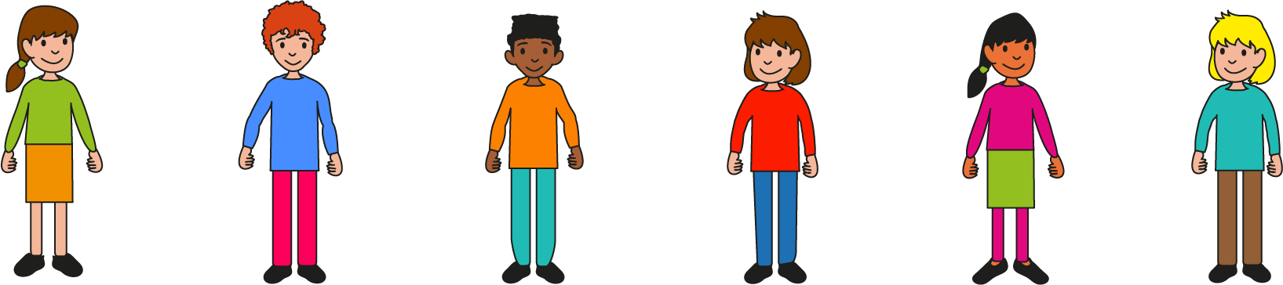
Did you guess that my number was 5?
Double 5 is 10! Did you just know or did you think of using halves? Half of 10 is 5 so double 5 must be 10!
Can you guess the number I am thinking of?
I’m thinking of a number and when I double it, I get 10. What number am I thinking of?
Double _____ is _____ .
Mastering Number 2021/22 ncetm.org.uk

Slide 17
I can make a NEAR DOUBLE by making a double and adding 1.
Double _____ is _____ ; add 1 is _____ .
Mastering Number 2021/22 ncetm.org.uk

Slide 18
I can make a near double by making a double and taking 1.
Double _____ is _____ ; take 1 is _____ .
Mastering Number 2021/22 ncetm.org.uk

Slide 19
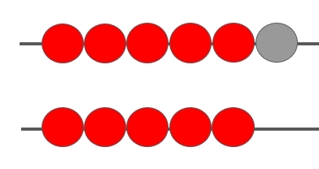
What additions could you write for these near doubles?
5 + 6
6 + 5
Mastering Number 2021/22 ncetm.org.uk

Slide 20
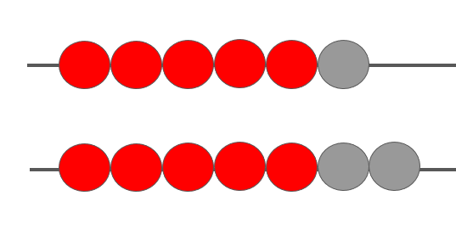
Can you find 2 ways to MAKE and CALCULATE 6 + 7?
6 + 7 =
13
Double _____ is _____ ; add 1 is _____ .
Double _____ is _____ ; take 1 is _____ .
Mastering Number 2021/22 ncetm.org.uk

Slide 21

Say whether these calculations are near doubles or NOT.
7 + 8
30 + 29
9 + 8
30 + 26
17 + 8
30 + 31
Mastering Number 2021/22 ncetm.org.uk

Slide 22
Solve these calculations
6 | + | 7 | =
8 | + | 9 | =
7 | + | 6 | =
9 | + | 8 | =
5 | + | 6 | =
8 | + | 7 | =
6 | + | 5 | =
7 | + | 8 | =
Mastering Number 2021/22 ncetm.org.uk

Slide 23
Session 3
Mastering Number 2021/22 ncetm.org.uk

Slide 24
Which of these arrangements is a double?
Why is it easy to spot a double?
Mastering Number 2021/22 ncetm.org.uk

Slide 25
Can you make the same arrangement on your rekenrek and then turn it into a double? Can you do it WITHOUT changing the total number of beads?
I have noticed a new way to create a double on the rekenrek…
Mastering Number 2021/22 ncetm.org.uk

Slide 26
How many beads did I move? Did I keep the TOTAL number of beads the same? Watch carefully…
Mastering Number 2021/22 ncetm.org.uk

Slide 27
I think my friend made a double by moving a bead on each row. I have written the calculations to match the rekenrek beads.
But… why did the total stay the same?
4 + 6 = 10
5 + 5 = 10
Mastering Number 2021/22 ncetm.org.uk

Slide 28
I made a double in the same way as my friend. Can you copy what I did?
Mastering Number 2021/22 ncetm.org.uk

Slide 29
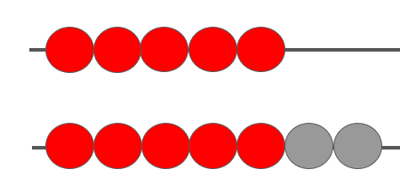
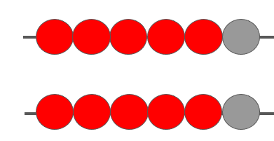
Think about how I changed each number to make a double.
5 + 7
6 + 6
Mastering Number 2021/22 ncetm.org.uk

Slide 30
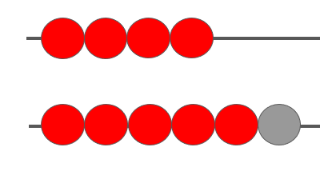
Did you notice that 1 number was 2 more than the other number in each expression?
What do you notice about the numbers we each started with?
4 + 6
5 + 7
Mastering Number 2021/22 ncetm.org.uk

Slide 31


