Slide 1
Maths Parents Workshop
December 2022

Slide 2
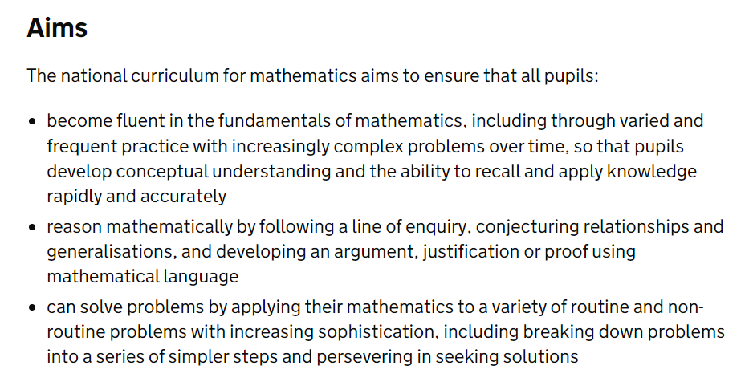


National Curriculum

Slide 3
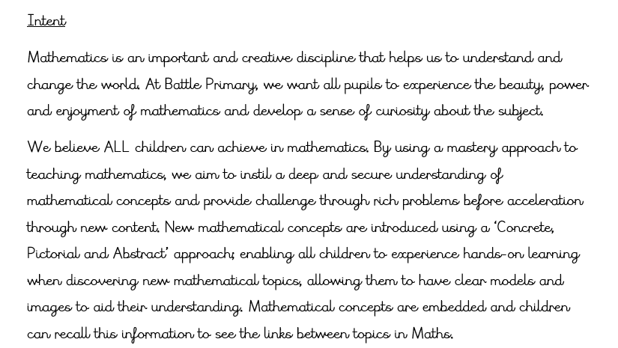


Maths at Battle

Slide 4
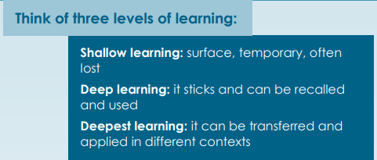
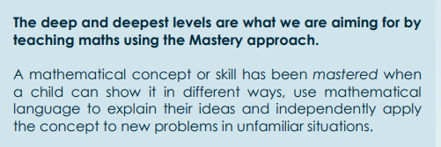
Mastery Approach

Slide 5
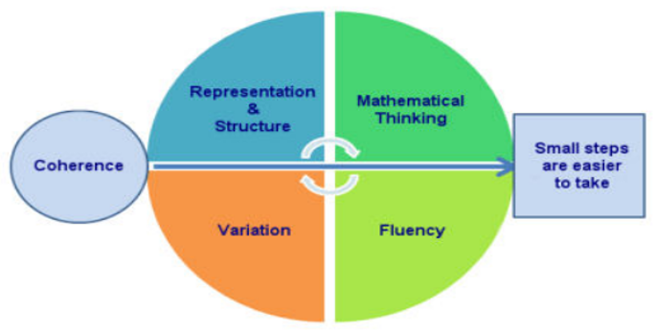
Mastery Approach

Slide 6
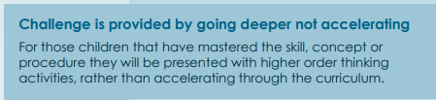
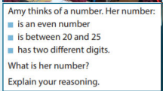
Mastery Approach

Slide 7
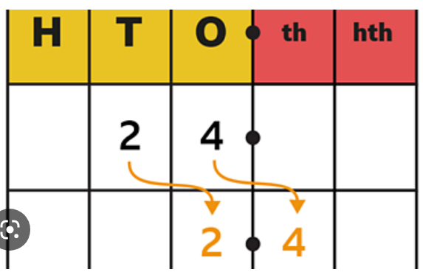
Stem Sentences
To divide by ________ move each digit ______
place to the ________________.

Slide 8
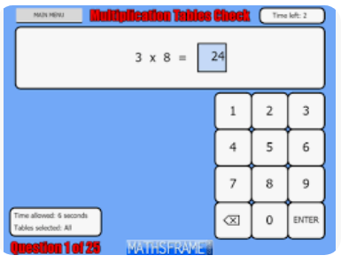
Times Tables

Slide 9
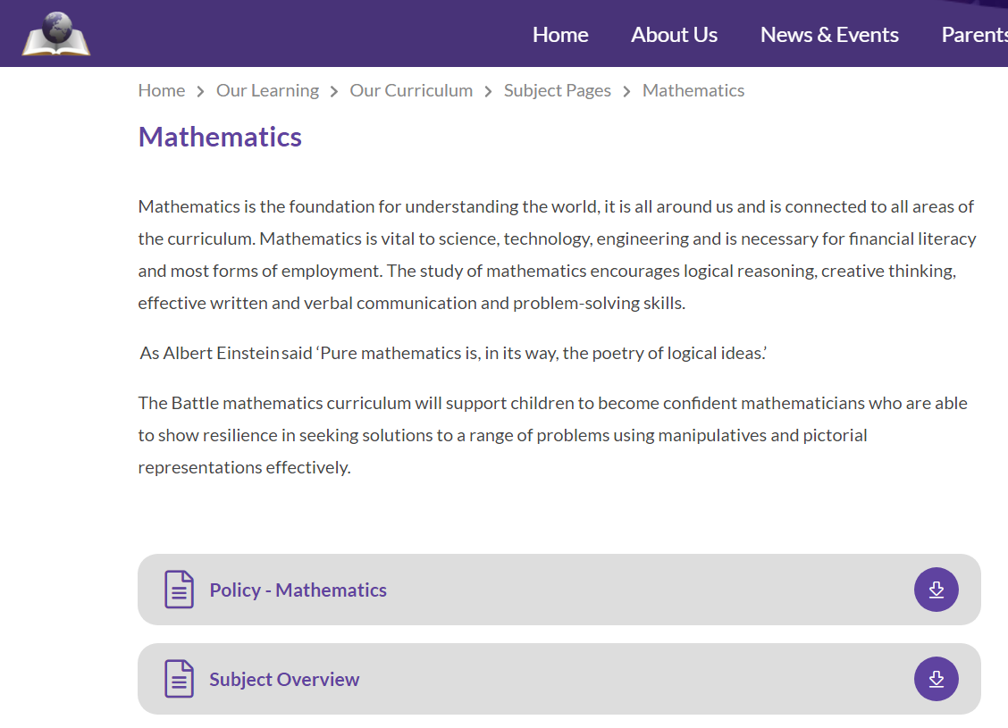
Where can you find out more?

Slide 10
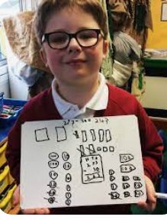
What are your children learning?
Please go to your children’s year group
The children are going to show you the methods they have been learning
Please feel free to ask the children and teachers questions about
their learning

