Slide 1
Maths Parents Workshop
December 2023

Slide 2
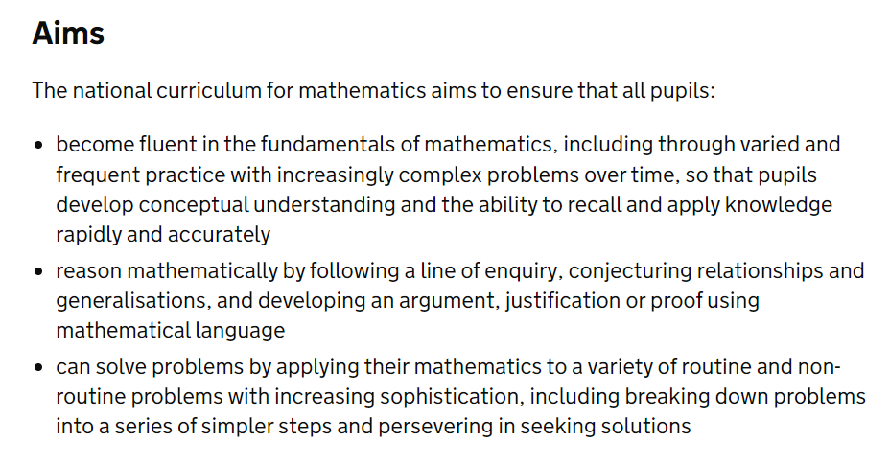


National Curriculum

Slide 3
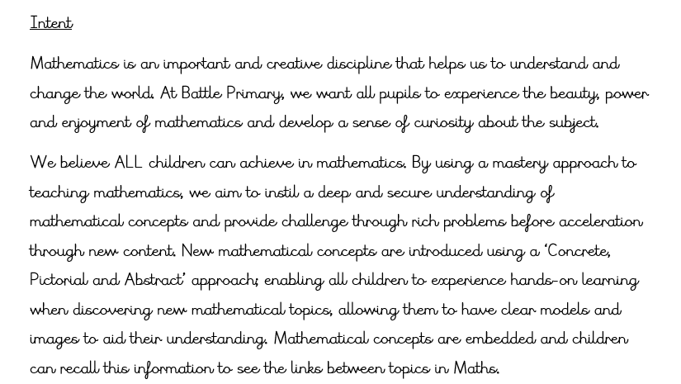


Maths at Battle

Slide 4
What is a good mathematician at Battle?

Slide 5
Mathematical children are…
Patterns sniffers | Look for patterns in numbers. Curious about numbers. Show perseverance.
Describers | Used to talking about maths, explaining their thinking and describing patterns and links.
Conjecturers | Suggests reasons why things happen and willing to make a guess and experiment.
Tinkerers | Willingness to try different things when problem solving and are curious asking ‘what if…’
Experimenters | Approach problem solving in a logical way, changing one variable when trying an idea. Are able to draw on many strategies. Ideas prompted by a conjecture.
Inventors | Develop new strategies and ideas through experimenting. Enjoy opportunities to be creative.
Generalisers | Can apply what they know to new situations. Ask questions such as ‘does this always happen…?’
Habits of mind: an organising principle for the mathematics curriculum
Cuoco, Goldenberg & Mark (2008)

Slide 6
How do we help your children to achieve this?

Slide 7
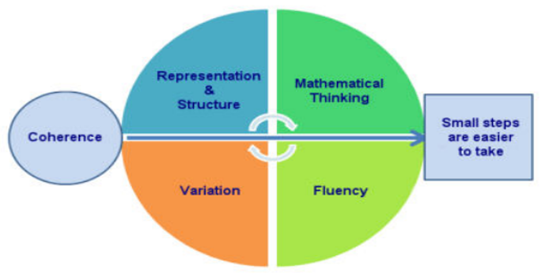
Mastery Approach

Slide 8

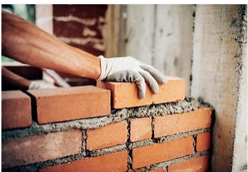

Small Steps

Slide 9
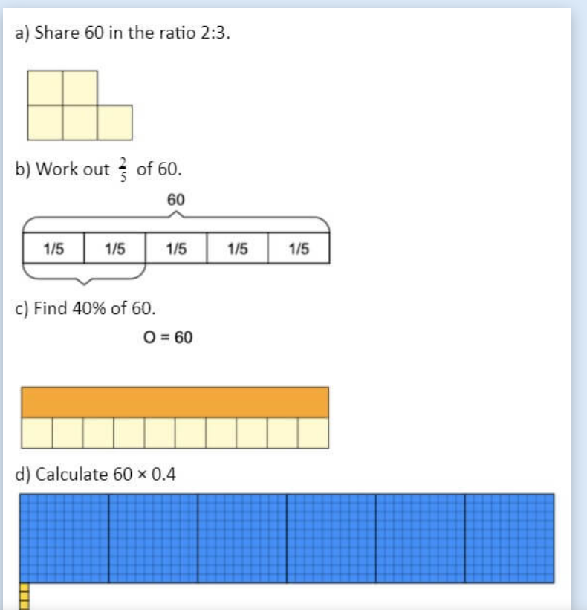
Variation

Slide 10
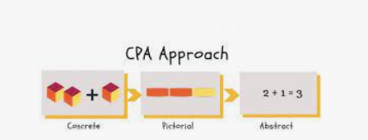
Representation and Structure

Slide 11
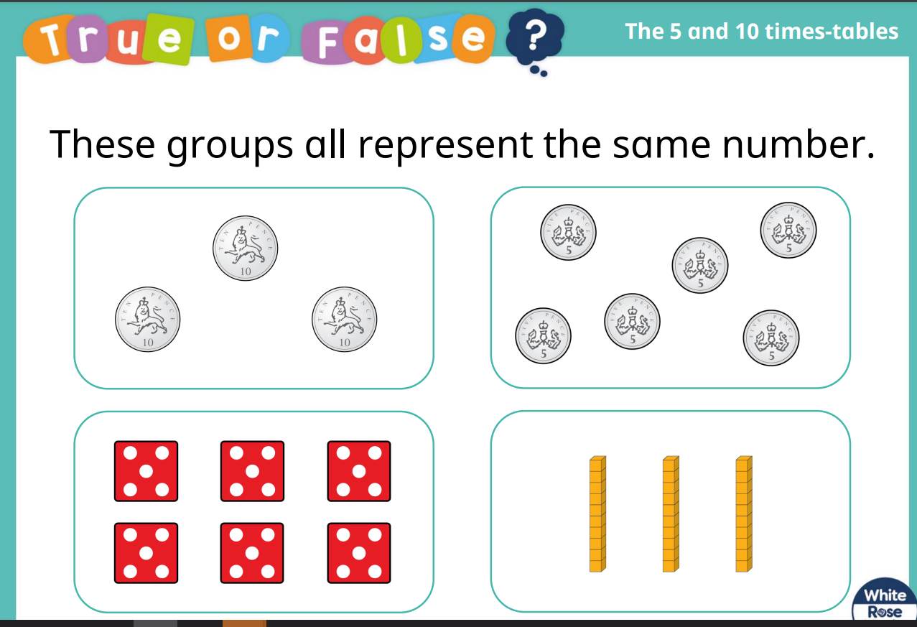
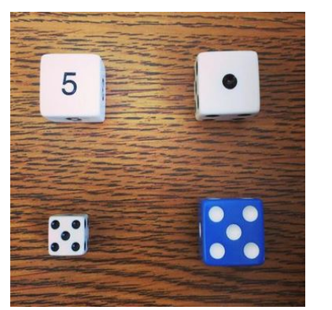
Mathematical Thinking

Slide 12
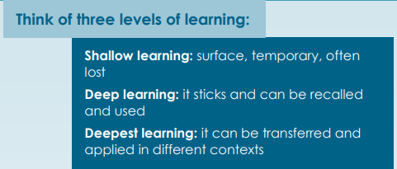
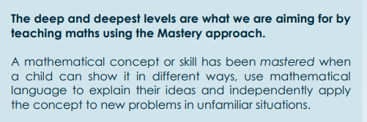
Mastery Approach

Slide 13
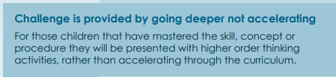
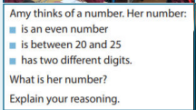
Mastery Approach

Slide 14
Mastering Number

Slide 15

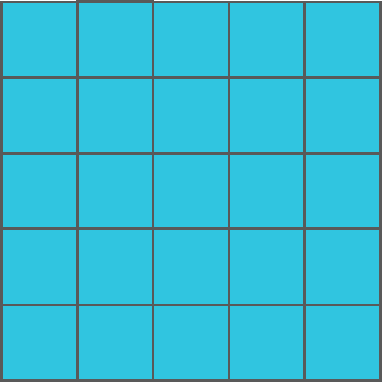
Fin makes some shapes with blocks. Which arrangements make square shapes?
✗
✓
✓
✗
✓
✓
✗
✓
✗

Slide 16
Look at this square shape. Who do you agree with?
I can see 3 threes like this.
I can see 3 threes like this.
3
Mo
Fin
3
There are _____ _____ .
There is _____ , _____ times.

Slide 17
Write an expression to match the stem sentence. What do you notice about the factors?
3
3
3 × 3
There are _____ _____ .
There is _____ , _____ times.

Slide 18
If Fin writes an expression to match each square shape, will the factors in each expression be the same?
1 × 1
2 × 2
3 × 3
4 × 4
There is _____ _____ . There is _____ , _____ time.
There are _____ _____ . There is _____ , _____ times.

Slide 19
Fin correctly writes the product for each expression. What do you notice about the PRODUCT for each square shape?
The product is equal to the number of smaller blocks in each square.
16
9
4
1
1 × 1 = 1
2 × 2 = 4
3 × 3 = 9
4 × 4 = 16

Slide 20
Complete the sentence
1 | × | 1 | = | 1
2 | × | 2 | = | 4
3 | × | 3 | = | 9
4 | × | 4 | = | 16
When _______ factors that are the same are multiplied together, the __________ is a square number.
two
product

Slide 21
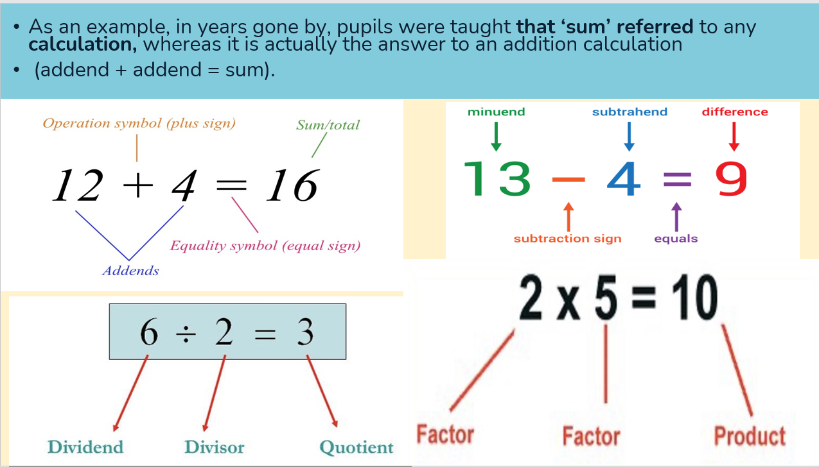
Use of mathematical vocabulary

Slide 22
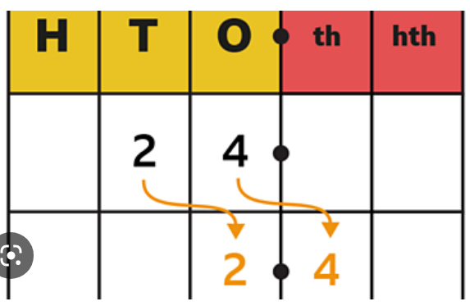
Stem Sentences
To divide by ________ move each digit ______
place to the ________________.

Slide 23

Times Tables

Slide 24
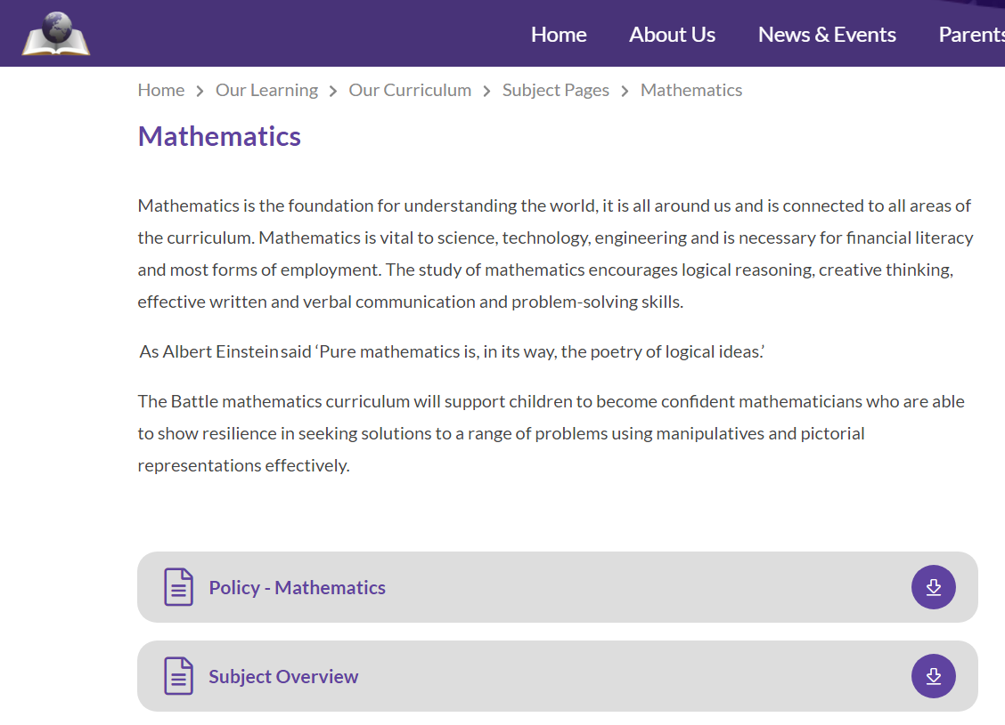
Where can you find out more?

Slide 25
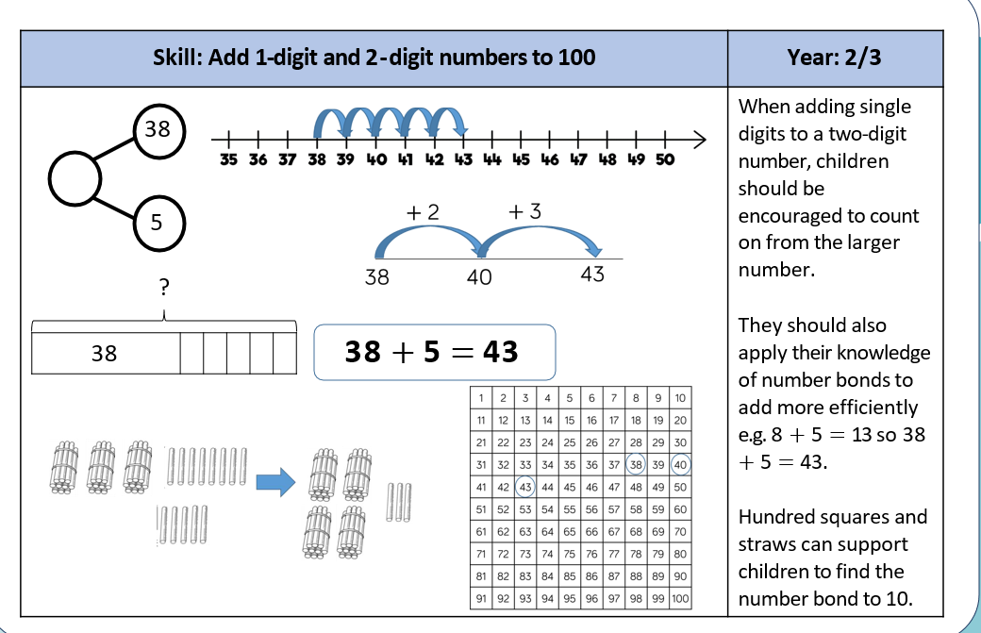
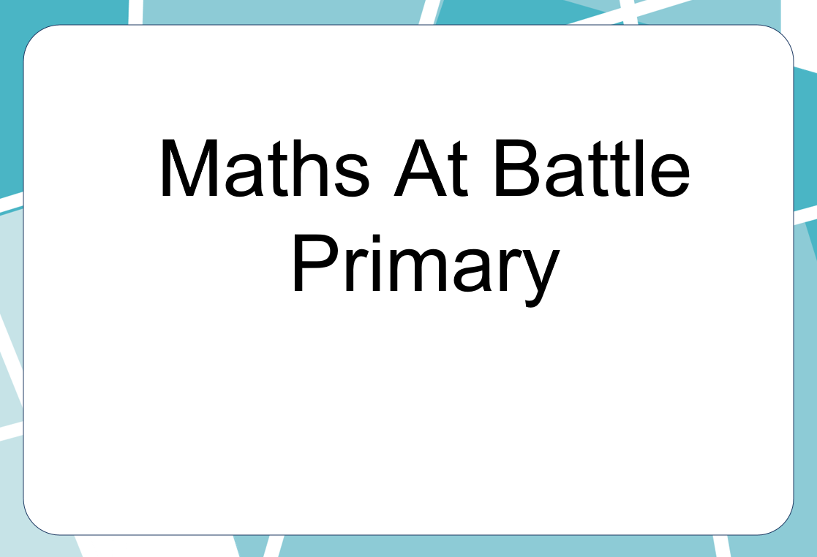
What is on the website?

Slide 26
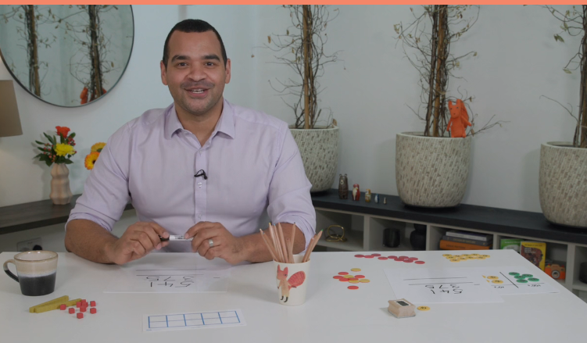
What is on the website?
https://whiteroseeducation.com/parent-pupil-resources/maths/maths-with-michael

Slide 27
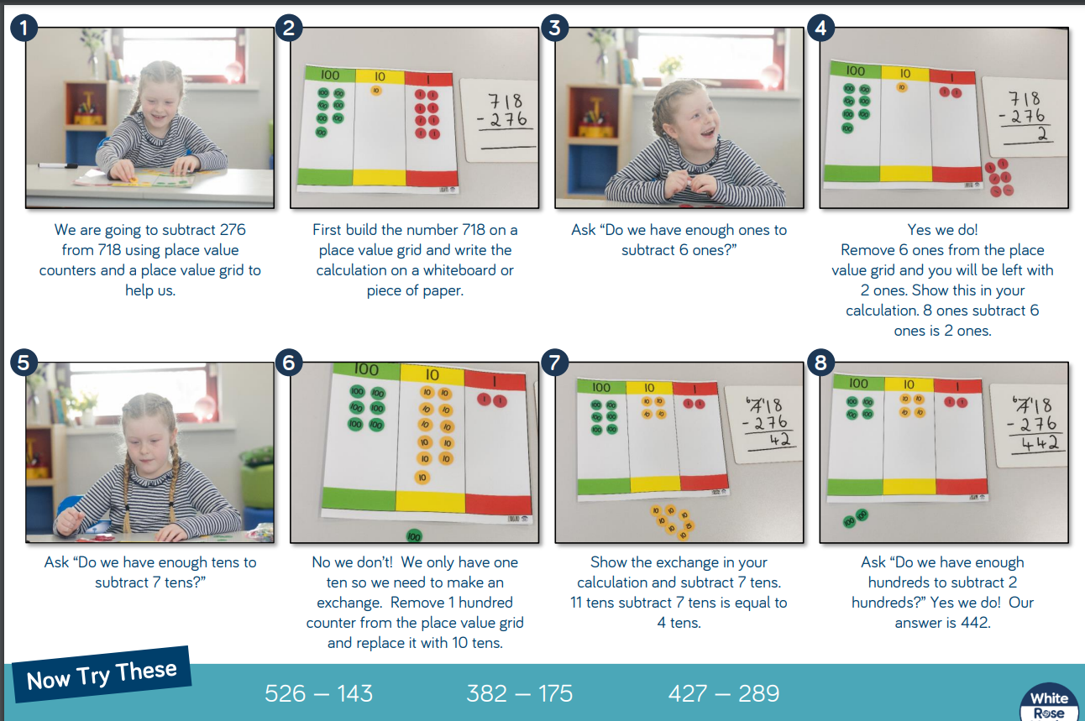


What is on the website?
https://whiteroseeducation.com/parent-pupil-resources/maths/maths-with-michael

Slide 28
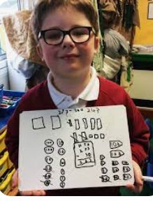
What are your children learning?
Please go to your children’s class
The children are going to show you the methods they have been learning
Please feel free to ask the children and teachers questions about
their learning

